Slide 1
Angular 4 ( Formally Angular 2)
Delivered By Yaswant Kumar
Capgemini India PVT LTD

Slide 2
Day 1: Interactive session & Agenda
Team interactions
Skills we need before starting angular training
HTML
CSS with Bootstrap (Adds benefits)
JavaScript (Object oriented Javascript)
Typescript (Adds more benefit while working. Entire angular 2&4 will work with typescript)
Http protocols calling (optional)
Angular 1 (Add benefit partially)
Discuss the Agenda of training
Basic overview

Slide 3
What we are going to cover
Getting Started
Basics
Components & Databinding
Directives
Services & Dependency injections
Routing
Observables
Forms
Pipes
Http
Authentication
Optimizations & NgModules
Deployment
Animations & Testing

Slide 4
Getting Started
What is Angular?
Angular versions
Preinstalled tools
Angular project setup
Editing our first application message
What is typescript
Setup our project with bootstrap

Slide 5
What is Angular
Angular is used to implement reactive Single Page Applications (SPA)
It can be useful in cross platform applications (Web applications, mobile applications)
Contains Module structure and easy to modulate the work
No more page refresh
Fast data loading in the page

Slide 6
Angular vs Angular2 VS Angular 4
Angular 1 is the basic version of Angular Js which is currently no more suggestable in the market
Angular 1 is not a modular structure
Angular 2 is Completely rebuild on Angular 1
Angular 2 has its own syntax and its module structure
Angular 2 uses typescript. Its not recommended to write JavaScript inside the typescript
Angular 4 is just an upgradation of core libraries and few more libraries nothing to do with syntax changes
Future is Angular 2 which is currently known as Angular

Slide 7
What we need to install before angular setup
Latest Node.js (Nothing to do with Server scripting Angular CLI will work with node Js)
Typescript
Angular CLI

Slide 8
What is typescript
Superset to JavaScript (Type, classes, interface etc.)
More features than vanilla JS
Doesn’t run in Browser
Compile on JavaScript
In the browser JavaScript is going to run

Slide 9
Project Setup
npm install –g @angular/cli
ng new projectname
cd projectname
ng serve

Slide 10
Thankyou

Slide 11
Day 2: How to install bootstrap & Basics
How an Angular App gets loaded?
Fragmentation of layouts
What is components
What is the usage of app.module.ts
Creating New component
How to change our default root page instead of appcomponent
Working with Component templates
Working with component styles

Slide 12
Editing Welcome Greeting Message

Slide 13
Setup with bootstrap
npm install --save bootstrap
Add the css and js inside the angular-cli.json

Slide 14
How Angular App load initially
Default loading page will be indxed.html
app-root selector containing loading.. But we can’t able to see loading . From where the default content is loading
While running angular first code execution page will be main.ts
It contains the default module loaded by the bootstrap
app.module.ts contains the default component details
We can change our default loading components and app-root selector. It’s not necessary to load the data inside app-root selector only

Slide 15
Layout Fragment
It’s necessary how we fragmented our layout
Each fragment called as a component
We can reuse our component anywhere through the application
Add the bootstrap to give more power to the UI
Easy to identify the modules available inside the application

Slide 16
Components
Components known as modules we fragmented inside the application
We can create our own custom component by hand or with CLI
Each component may or may not communicate with each other depends on the requirement

Slide 17
Understand app.module
Here we are going to import our components, providers, classes
Default page load module by bootstrap
It helps to tell angular which component should load initially

Slide 18
Creating new component
ng g c componentname
Angular CLI will add the import classes to the app.module automatically
If we create by hand we have to add the import and declarations sections with our component name.
Good way to use is CLI

Slide 19
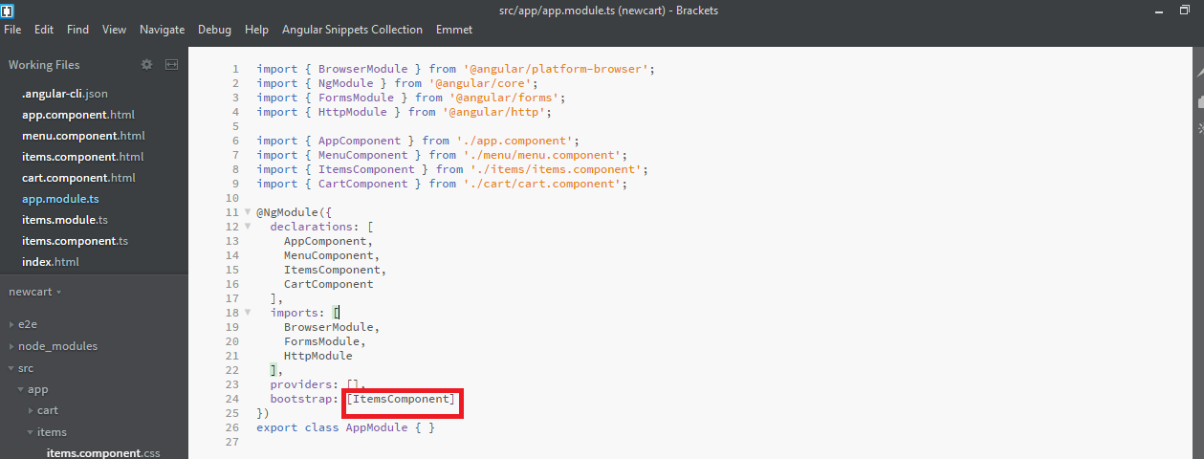
Change default loading page
Change bootstrap component section initially which component you want to load

Slide 20
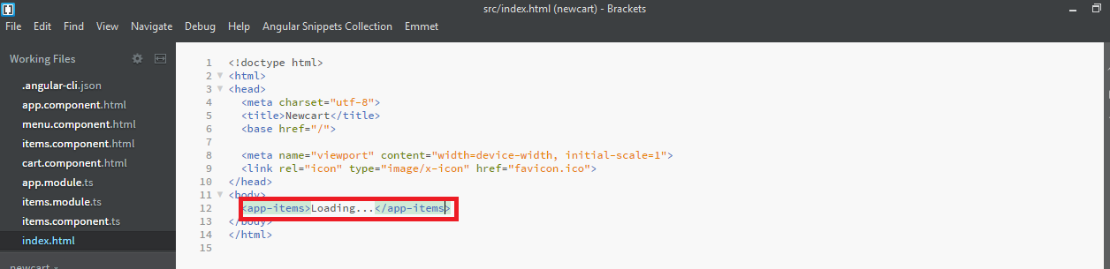
Change the app root to app-Items in index.html
That’s all you changed the default loading page

Slide 21
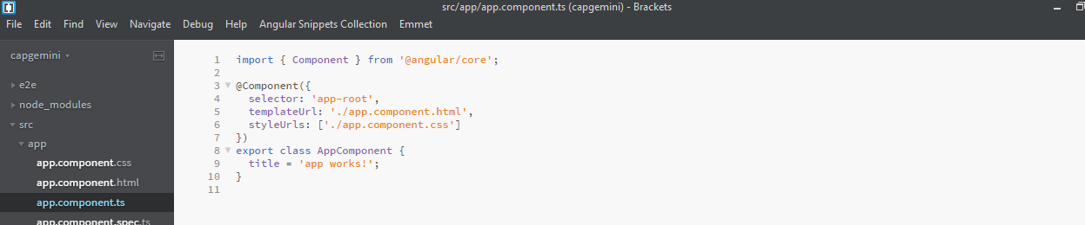
Working with Component template
Under component section we have templateUrl to specify the template where to load
Inplace of templateUrl we can use template selector and add our template directly inside it

Slide 22
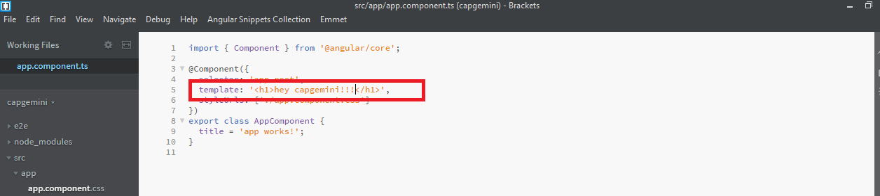
Working with Component template
If our template contains less than 3 lines our code then its better to use template than creating a file and use it
If its more than 3 lines always best practice use different file and tag it

Slide 23
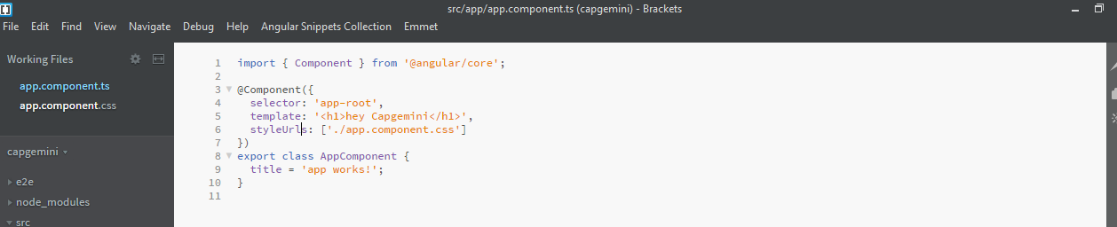
Working with Component style
Similar Templateurl – styleUrls.
Its an array because we load external css also inside this component
To add the css to this component we can define our css inside component.css file externally

Slide 24
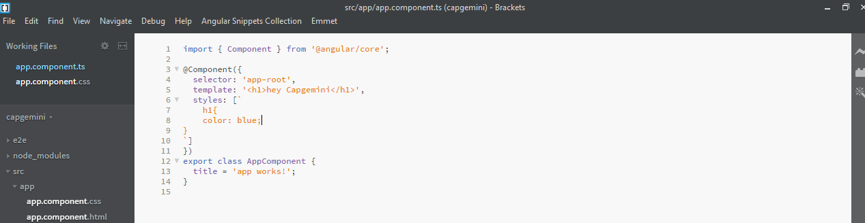
Working with Component style
Way to add inline css to our template by using styles selector

Slide 25
Thankyou

Slide 26
Day 3: Databinding and string interpolation
What is databinding?
String interpolation
Property binding
Property binding vs string interpolation
Event binding
Passing and using data with event binding
Two way databinding

Slide 27
Understanding Data binding
Communication between typescript code and template
Types of databinding (output data)
String interpolation {{ data }}
Property Binding [property] = “data”
React to (user) events
Event Binding (event) = “expression”
Example : click
Combination of both ( two way binding) [(ngModel)] = “data”

Slide 28
String interpolation
Inside the component.ts add the dummy values and use it in component.html
For example in component.ts
username: string = "yaswanth";
status: string = "offline";
Now in component.html
<div class="col-md-7">
<h2>{{ "Welcome" }} <b>{{ username }}</b> is <b>{{ status }}</b> now</h2>
</div>

Slide 29
Property Binding
Adding the properties to the html
For example in component.ts
allowNewUser = false;
constructor(){
setTimeout(()=>{
this.allowNewUser = true;
},2000);
}
Now in component.html
<button class="btn btn-primary"
[disabled] = "!allowNewUser"
>Add user</button>

Slide 30
Property Binding vs String interpolation
<button class="btn btn-primary"
[disabled] = "!allowNewUser"
>Add user</button>
<p>{{ allowNewUser }}</p>
<p [innerText] = "allowNewUser"></p>

